Slide 1

AI POWERED BOOK RECOMMENDATION APP
INTRODUCING BOOK GENIE
By Mirza Awez Baig & Namit Gourkhede
Problem Statement: Build an app that suggests book recommendations based on user preferences. Users can input genres they enjoy, and the app should provide book suggestions

Slide 2
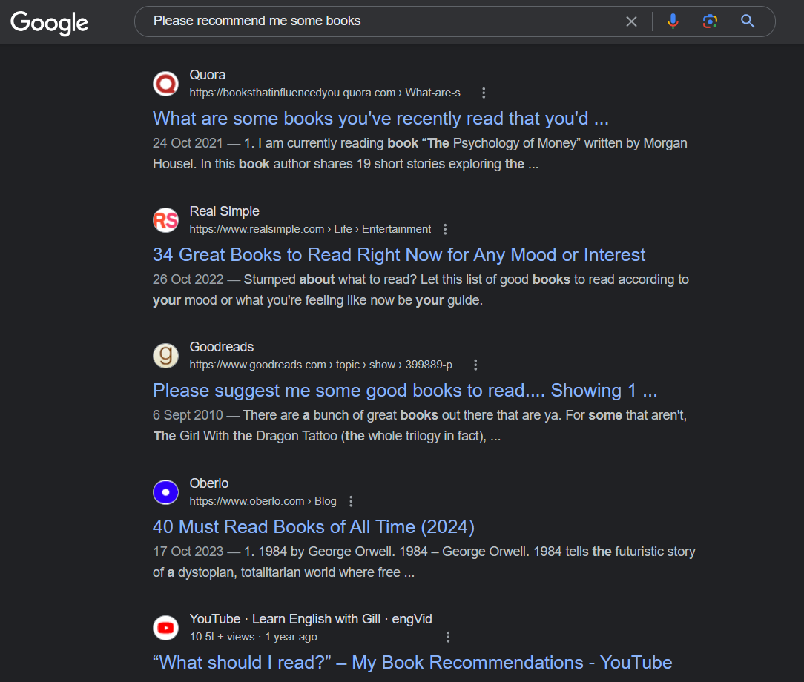
Find books based on you mood
Before Book Genie, life was difficult.
We used to go through a lot of website for finding just a single book.

Slide 3
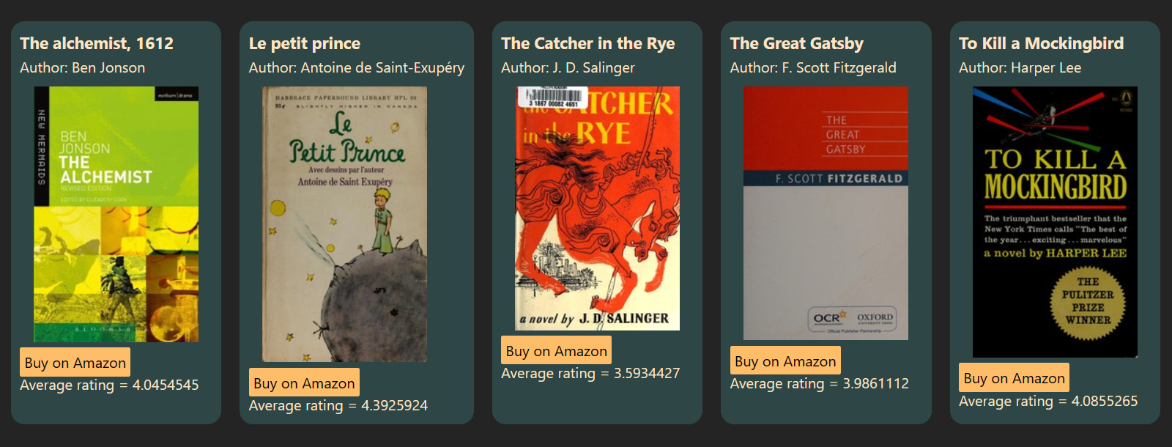
Welcome to the future!
AI made it possible to just get the book by a single prompt.
We used to go through a lot of website for finding just a single book
Book Genie: “Jo hukum mere aaka!”

Slide 4
Lets see how our Genie works

Slide 5
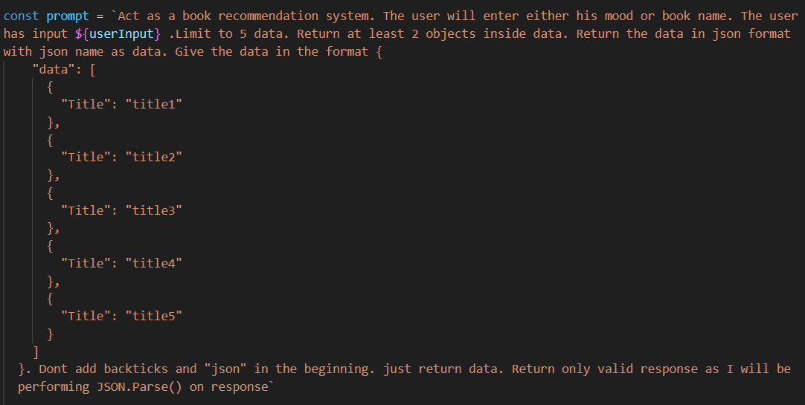
User asks his wish to Book Genie by entering his mood in input box
The genie receives the input and generates an AI prompt based on the input

Slide 6
The generated prompt is then sent to Google’s Gemini.
We restrict the Gemini to send back response with max. 5 books in JSON format

Slide 7
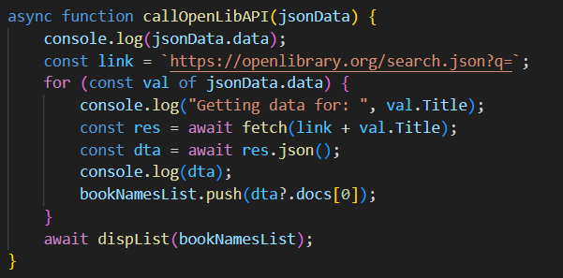
We calls the OPEN BOOKS API collection to get the books data.

Slide 8

The received response is then rendered on the frontend after processing the data using DOM Manipulation
Data like title, author name, book poster is rendered along with the buttons to Buy the book and its rating

Slide 9
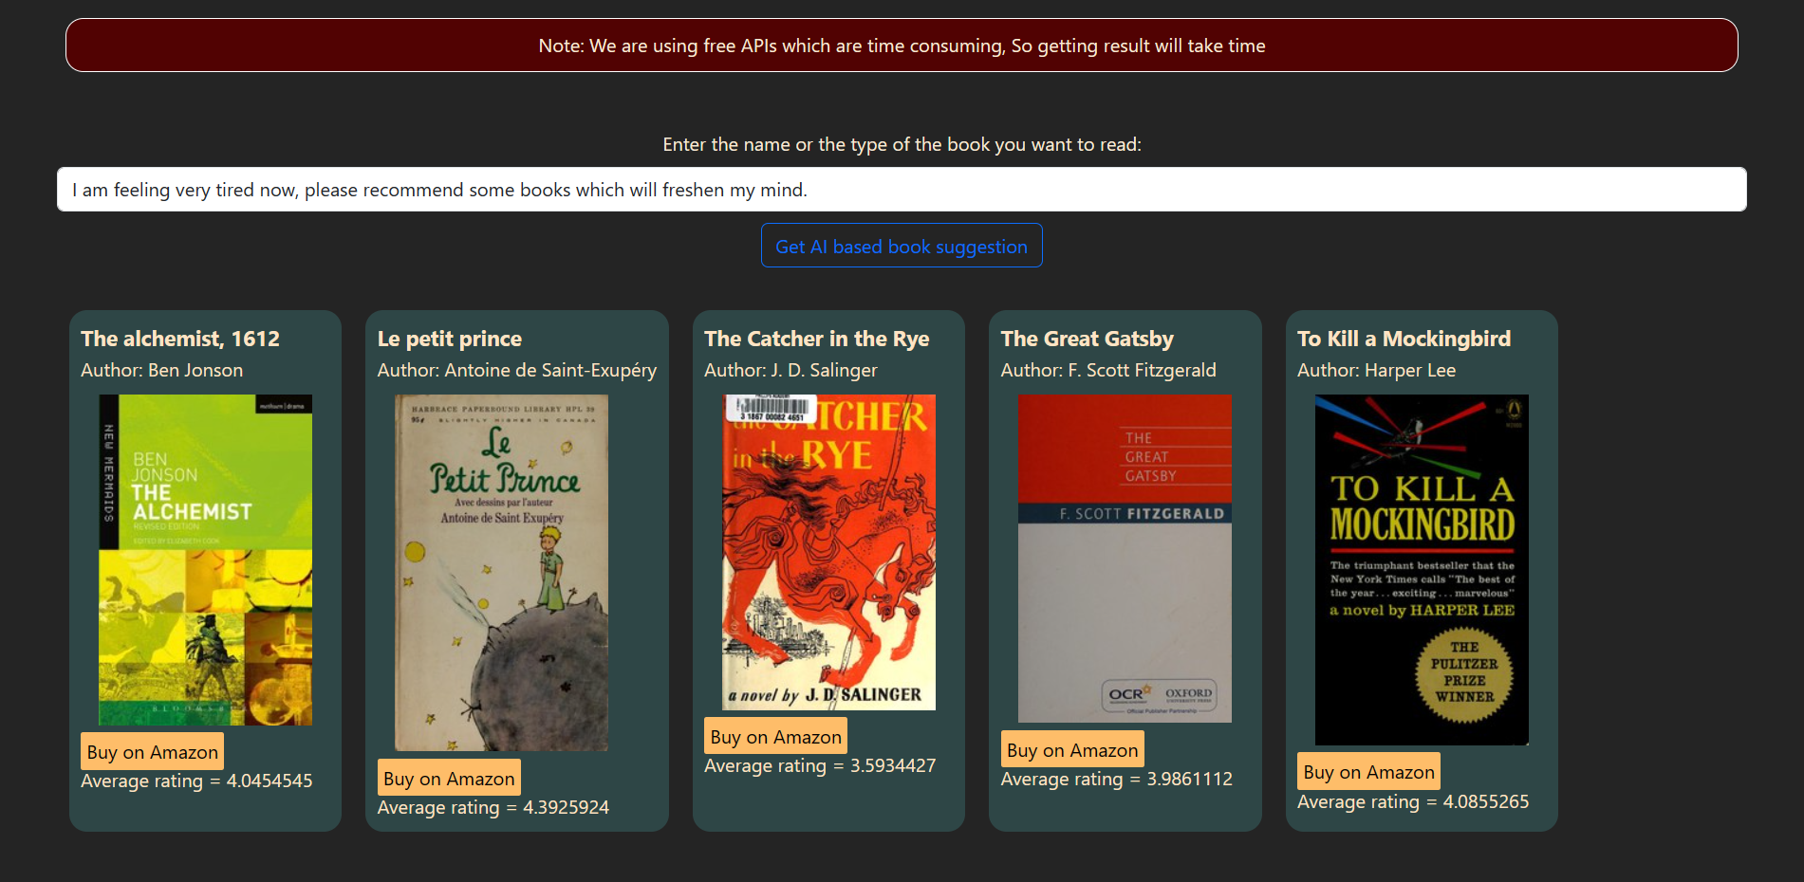
Explore the future of reading with Book Genie.

